Slide 1
Work System Design Lab
Rating Film Exercises.

Slide 2
Rating Film Exercise
Objective:
To measure the speed of different job with their standard time and giving their rating to the job.
To test the movement and muscular coordination of the body and give rating on that basis.
Material Required:
Recording Sheets
Pen and Pencil
Display (Movies of performance sample rating )
Operation:
The videos were watched by the students.
Each video consisted of a demonstration and three variant of it at three different speed.
The variant of the demonstration was rated taking the demonstration at normal speed.

Slide 3
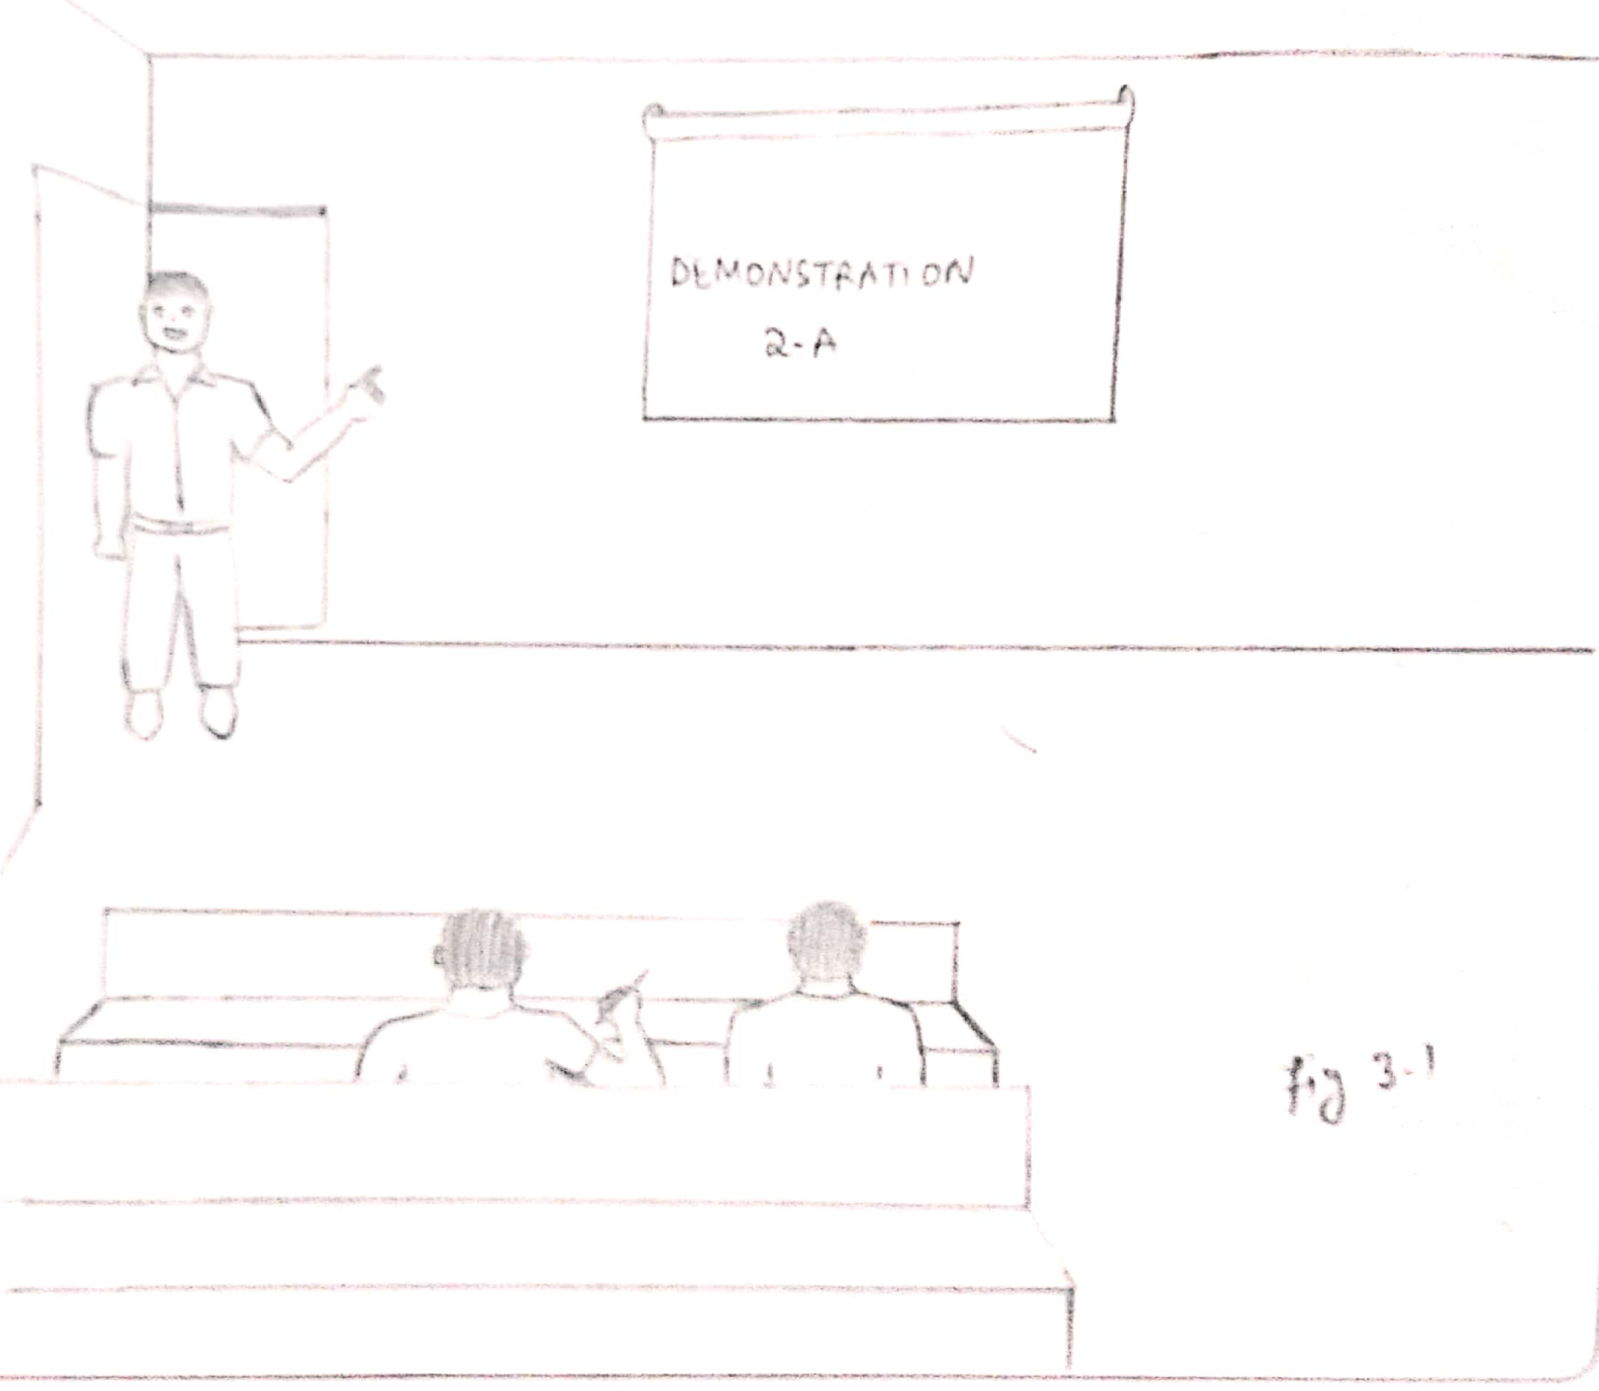
Rating Film Contd..
4. The rating was compared with the control reading and deviation from it was calculated.
Diagram:

Slide 4
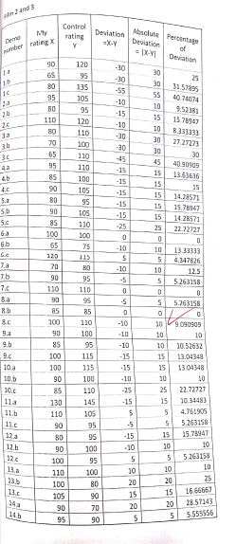
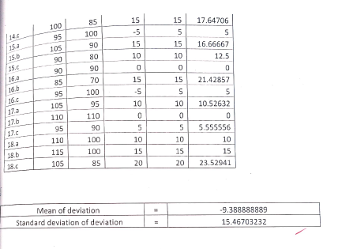
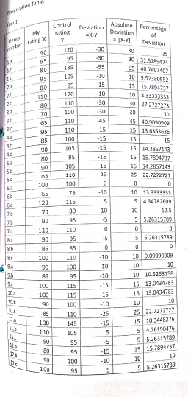

Slide 5
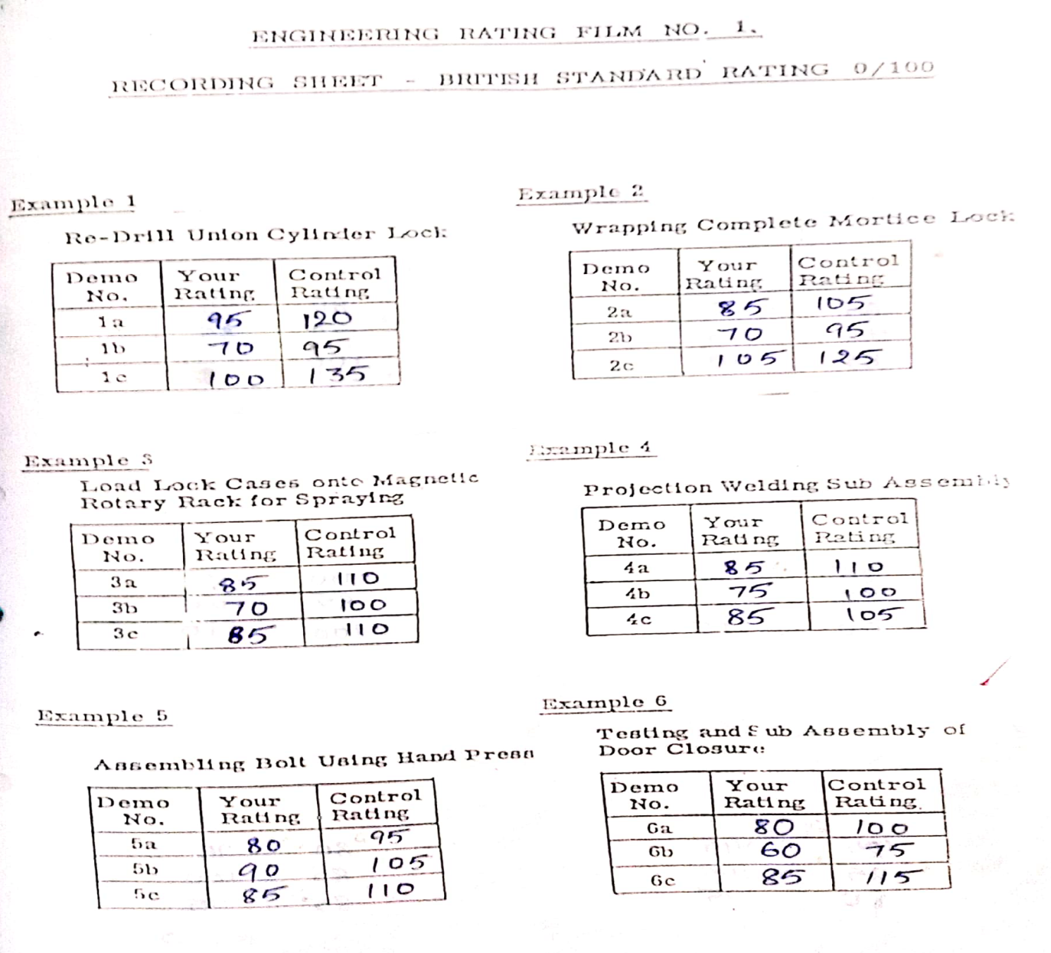
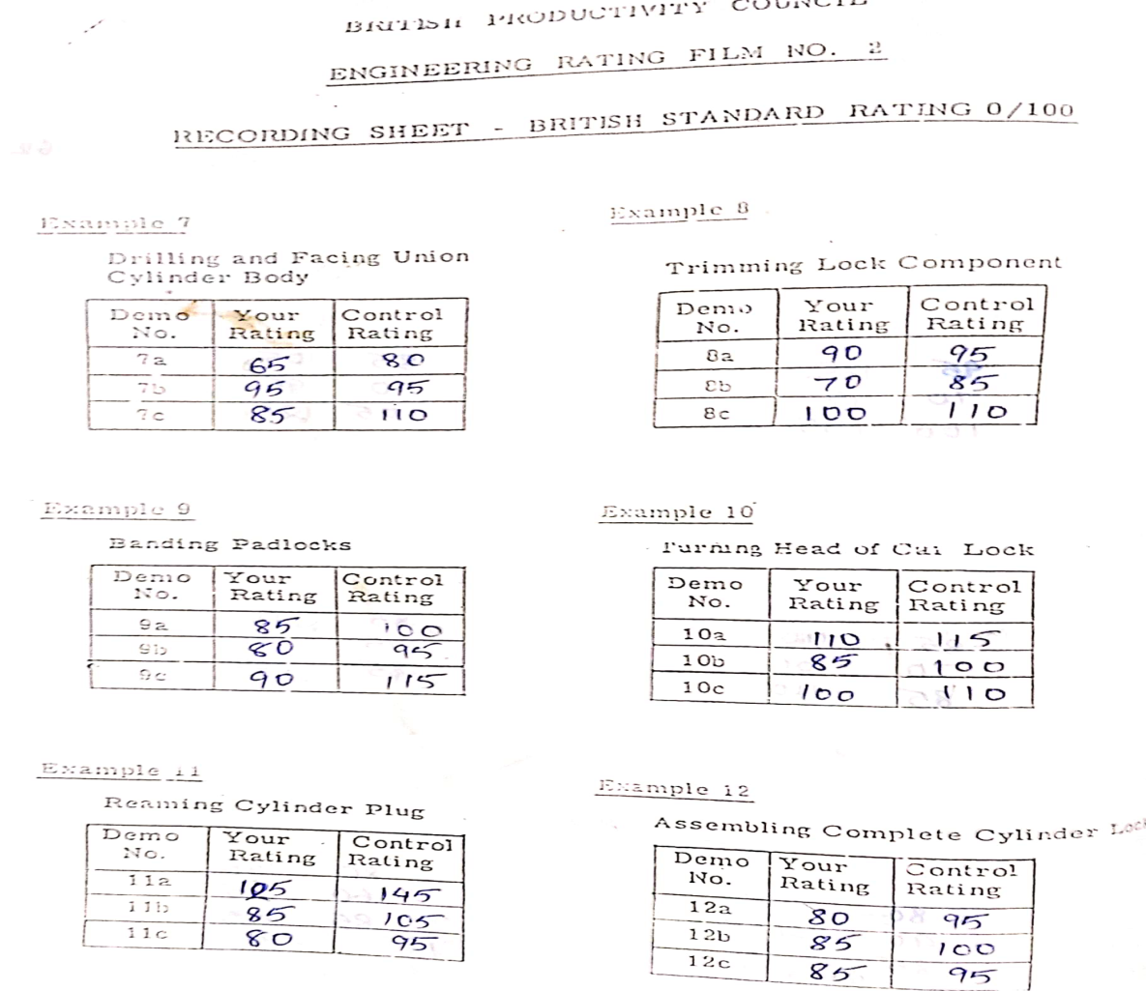
Data:

Slide 6
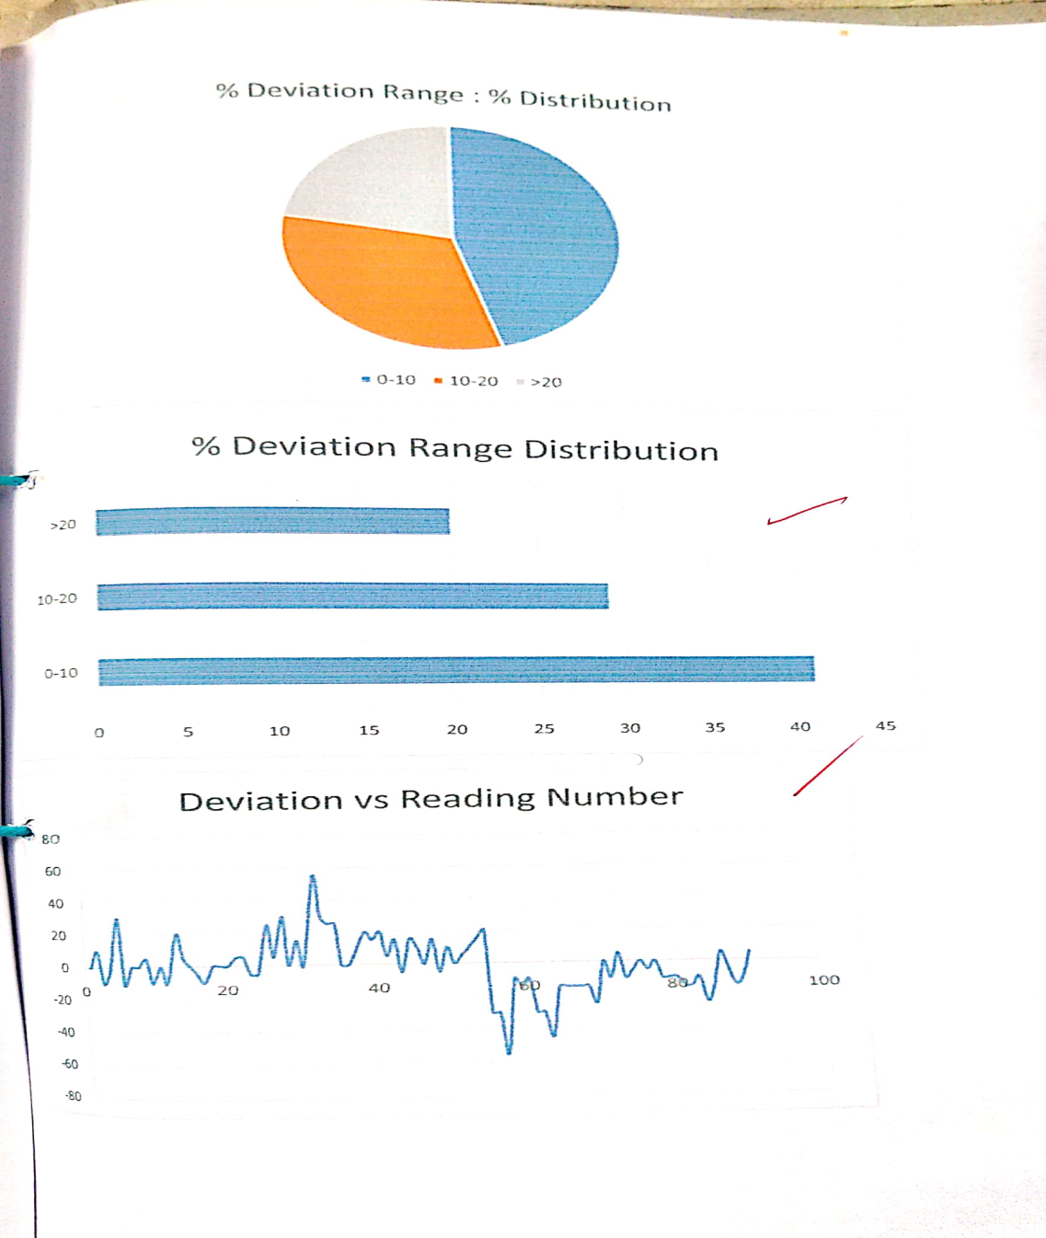
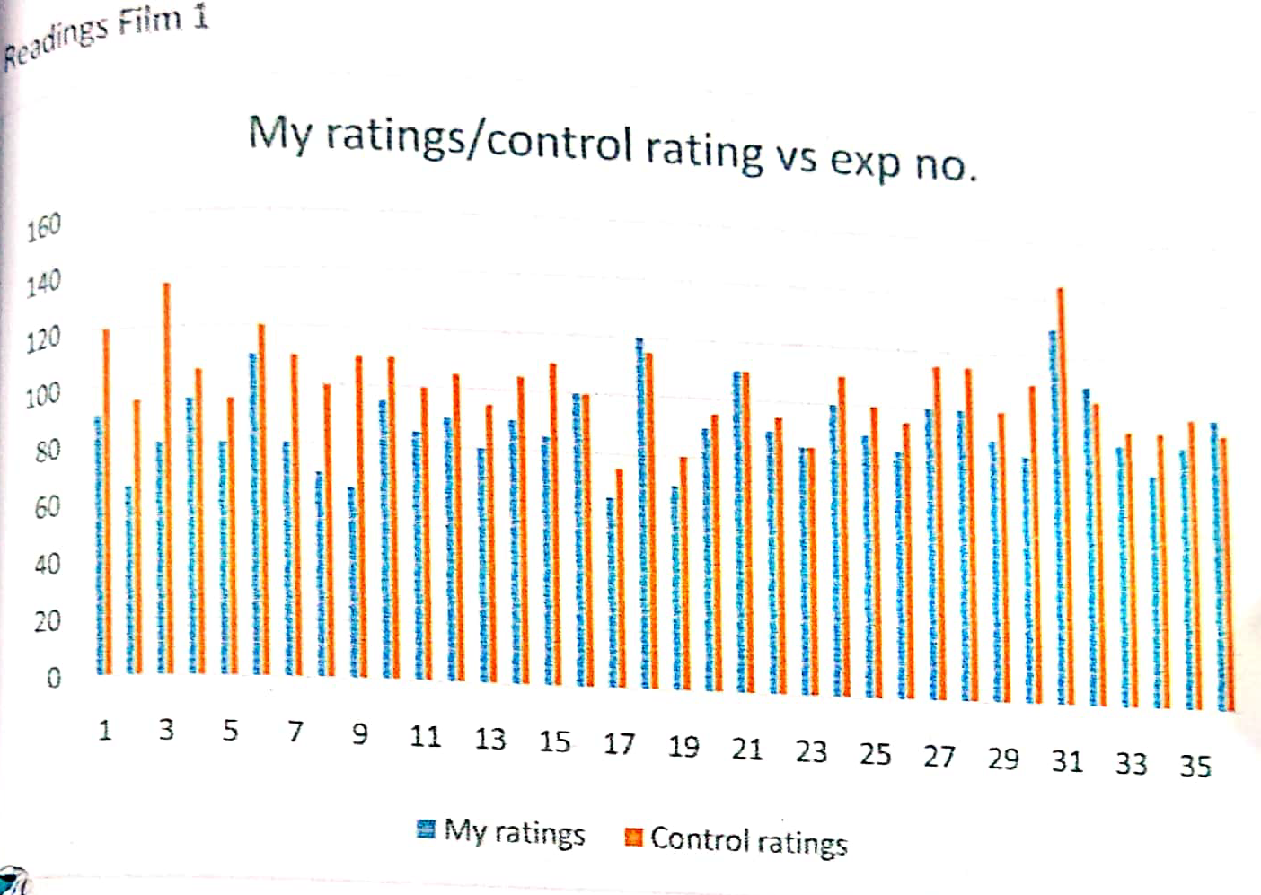
Contd..

Slide 7
Calculation
Area in the intersection, within 5

